Slide 1
Unit-4 Machine Learning

Slide 2
What is Machine Learning?
Machine Learning is concerned with computer programs that automatically improve their performance through experience.
Machine learning is an application of AI that enables systems to learn and improve from experience without being explicitly programmed.
Machine learning focuses on developing computer programs that can access data and use it to learn for themselves.

Slide 3
Why is ML important?
Machine learning is important because it gives enterprises a view of trends in customer behavior and operational business patterns, as well as supports the development of new products.
The term “machine learning” was coined by Arthur Samuel, a computer scientist at IBM and a pioneer in AI and computer gaming.
Samuel designed a computer program for playing checkers. The more the program played, the more it learned from experience, using algorithms to make predictions.

Slide 4
Why is ML important?
machine learning explores the analysis and construction of algorithms that can learn from and make predictions on data.
ML has proven valuable because it can solve problems at a speed and scale that cannot be duplicated by the human mind alone.
With massive amounts of computational ability behind a single task or multiple specific tasks,
machines can be trained to identify patterns in and relationships between input data and automate routine processes.

Slide 5
Why is ML important?
Data Is Key: The algorithms that drive machine learning are critical to success.
ML algorithms build a mathematical model based on sample data, known as “training data,” to make predictions or decisions without being explicitly programmed to do so.
This can reveal trends within data that information businesses can use to improve decision making, optimize efficiency and capture actionable data at scale.
AI Is the Goal: ML provides the foundation for AI systems that automate processes and solve data-based business problems autonomously.
It enables companies to replace or augment certain human capabilities.
Common machine learning applications you may find in the real world include chatbots, self-driving cars and speech recognition.

Slide 6
Applications of ML
Data security: Machine learning models can identify data security vulnerabilities before they can turn into breaches.
By looking at past experiences, machine learning models can predict future high-risk activities so risk can be proactively mitigated.
Finance: Banks, trading brokerages and fintech firms use machine learning algorithms to automate trading and to provide financial advisory services to investors.
Bank of America is using a chatbot, Erica, to automate customer support.
Healthcare: ML is used to analyze massive healthcare data sets to accelerate discovery of treatments and cures, improve patient outcomes, and automate routine processes to prevent human error.
For example, IBM’s Watson uses data mining to provide physicians data they can use to personalize patient treatment.

Slide 7
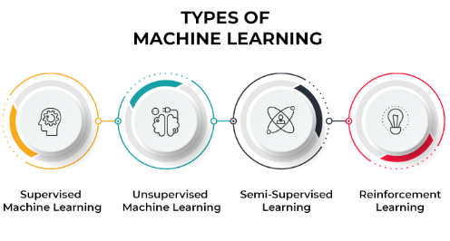
Fraud detection: AI is being used in the financial and banking sector to autonomously analyze large numbers of transactions to uncover fraudulent activity in real time.
Technology services firm Capgemini claims that fraud detection systems using machine learning and analytics minimize fraud investigation time by 70% and improve detection accuracy by 90%.
Retail: AI researchers and developers are using ML algorithms to develop AI recommendation engines that offer relevant product suggestions based on buyers’ past choices, as well as historical, geographic and demographic data.

Slide 8
Types of ML
Supervised learning: We are given an input, for example a photograph with a traffic sign, and the task is to predict the correct output or label, for example which traffic sign is in the picture (speed limit, stop sign, etc.).
In the simplest cases, the answers are in the form of yes/no (we call these binary classification problems).
Unsupervised learning: There are no labels or correct outputs. The task is to discover the structure of the data:
for example, grouping similar items to form “clusters”, or reducing the data to a small number of important “dimensions”.
Data visualization can also be considered unsupervised learning.

Slide 9
Types of ML
Reinforcement learning: Commonly used in situations where an AI agent like a self-driving car must operate in an environment and where feedback about good or bad choices is available with some delay.
Also used in games where the outcome may be decided only at the end of the game.
The categories are somewhat overlapping and fuzzy, so a particular method can sometimes be hard to place in one category.
For example, as the name suggests, so-called semisupervised learning is partly supervised and partly unsupervised.

Slide 10
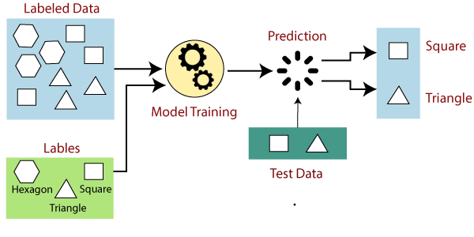
Supervised Learning
Supervised learning is an approach to machine learning (ML) that uses labeled datasets and correct outputs to train learning algorithms how to classify data or predict an outcome.

Slide 11
Supervised learning is useful for grouping data into specific categories (classification) and understanding the relationship between variables in order to make predictions (regression).
It is used to provide product recommendations, segment customers based on customer data, diagnose disease based on previous symptoms and perform many other tasks.

Slide 12
How supervised learning works?
Supervised learning uses a training set to teach models to yield the desired output.
This training dataset includes inputs and correct outputs, which allow the model to learn over time.
The algorithm measures its accuracy through the loss function, adjusting until the error has been sufficiently minimized.
Supervised learning can be separated into two types of problems when data mining—classification and regression:
Classification uses an algorithm to accurately assign test data into specific categories.
It recognizes specific entities within the dataset and attempts to draw some conclusions on how those entities should be labeled or defined. Common classification algorithms are linear classifiers, support vector machines (SVM), decision trees, k-nearest neighbor, and random forest, which are described in more detail below.
Regression is used to understand the relationship between dependent and independent variables.
It is commonly used to make projections, such as for sales revenue for a given business.
Linear regression, logistical regression, and polynomial regression are popular regression algorithms.

Slide 13
Classification
Classification algorithms are used when the output variable is categorical, which means there are two classes such as Yes-No, Male-Female, True-false, etc.
Spam Filtering
Random Forest
Decision Trees
Logistic Regression
Support vector Machines

Slide 14
Unsupervised learning
In Unsupervised Learning, the machine uses unlabeled data and learns on itself without any supervision.
The machine tries to find a pattern in the unlabeled data and gives a response.
Unsupervised learning is a type of machine learning in which models are trained using unlabeled dataset and are allowed to act on that data without any supervision.

Slide 15
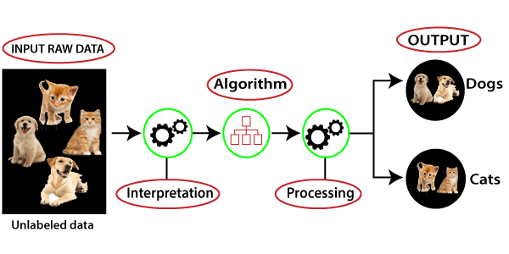
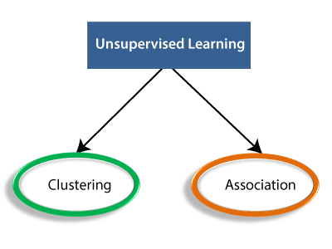

Slide 16
1. Clustering
Clustering is the method of dividing the objects into clusters that are similar between them and are dissimilar to the objects belonging to another cluster.
For example, finding out which customers made similar product purchases.

Slide 17
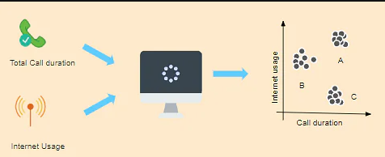
example
Suppose a telecom company wants to reduce its customer churn rate by providing personalized call and data plans. The behavior of the customers is studied and the model segments the customers with similar traits. Several strategies are adopted to minimize churn rate and maximize profit through suitable promotions and campaigns.
On the right side of the image, you can see a graph where customers are grouped.
Group A customers use more data and also have high call durations.
Group B customers are heavy Internet users, while Group C customers have high call duration.
So, Group B will be given more data benefit plants, while
Group C will be given cheaper called call rate plans and group A will be given the benefit of both.

Slide 18
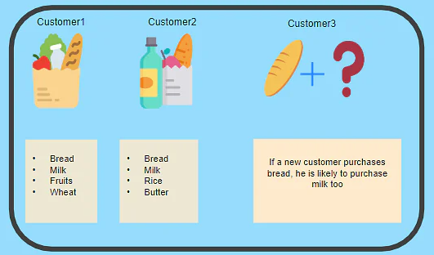
2. Association - Unsupervised Learning
Association is a rule-based machine learning to discover the probability of the co-occurrence of items in a collection. For example, finding out which products were purchased together.

Slide 19
Supervised Learning
Unsupervised Learning
It uses known and labeled data as input.
Supervised learning model takes direct feedback to check if it is predicting correct output or not.
Supervised learning model predicts the output.
In supervised learning, input data is provided to the model along with the output.
It uses unlabeled data as input
Unsupervised learning model does not take any feedback.
Unsupervised learning model finds the hidden patterns in data.
In unsupervised learning, only input data is provided to the model.

Slide 20
Supervised Learning
Unsupervised Learning
Supervised learning needs supervision to train the model.
Supervised learning can be categorized in Classification and Regression problems.
The most commonly used supervised learning algorithms are:
Decision tree
Logistic regression
Support vector machine
Unsupervised learning does not need any supervision to train the model.
Unsupervised Learning can be classified in Clustering and Associations problems.
The most commonly used unsupervised learning algorithms are:
K-means clustering
Hierarchical clustering
Apriori algorithm

Slide 21
Decision Trees
Decision Tree algorithm belongs to the family of supervised learning algorithms. Unlike other supervised learning algorithms, the decision tree algorithm can be used for solving regression and classification problems too.
The goal of using a Decision Tree is to create a training model that can use to predict the class or value of the target variable by learning simple decision rules inferred from prior data(training data).

Slide 22
Decision Tree
In Decision Trees, for predicting a class label for a record we start from the root of the tree.
We compare the values of the root attribute with the record’s attribute.
On the basis of comparison, we follow the branch corresponding to that value and jump to the next node.

Slide 23
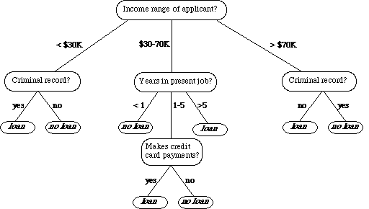
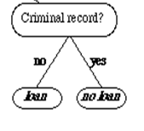

Slide 24
Important Terminology related to Decision Trees
Root Node: It represents the entire population or sample and this further gets divided into two or more homogeneous sets.
Splitting: It is a process of dividing a node into two or more sub-nodes.
Decision Node: When a sub-node splits into further sub-nodes, then it is called the decision node.
Leaf / Terminal Node: Nodes do not split is called Leaf or Terminal node.

Slide 25
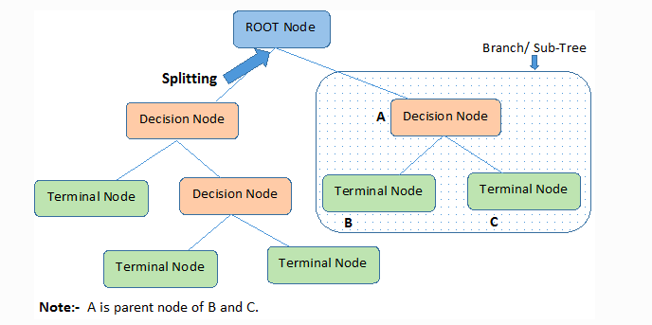

Slide 26
Important Terminology related to Decision Trees
Pruning: When we remove sub-nodes of a decision node, this process is called pruning.
Branch / Sub-Tree: A subsection of the entire tree is called branch or sub-tree.
Parent and Child Node: A node, which is divided into sub-nodes is called a parent node of sub-nodes whereas sub-nodes are the child of a parent node.

Slide 27
Decision trees use multiple algorithms to decide to split a node into two or more sub-nodes.
In other words, we can say that the purity of the node increases with respect to the target variable.
The algorithm selection is also based on the type of target variables. some algorithms used in Decision Trees:
ID3 →(Iterative Dichotomiser 3) CART → (Classification And Regression Tree)

Slide 28
ID3 Algorithm
The ID3 algorithm builds decision trees using a top-down greedy search approach through the space of possible branches with no backtracking.
A greedy algorithm, as the name suggests, always makes the choice that seems to be the best at that moment.

Slide 29
Steps in ID3 algorithm:
It begins with the original set S as the root node.
On each iteration of the algorithm, it iterates through the very unused attribute of the set S and calculates Entropy(H) and Information gain(IG) of this attribute.
It then selects the attribute which has the smallest Entropy or Largest Information gain.
The set S is then split by the selected attribute to produce a subset of the data.
The algorithm continues to recur on each subset, considering only attributes never selected before.

Slide 30
Attribute Selection Measures
If the dataset consists of N attributes then deciding which attribute to place at the root or at different levels of the tree as internal nodes is a complicated step.
By just randomly selecting any node to be the root can’t solve the issue.
If we follow a random approach, it may give us bad results with low accuracy.

Slide 31
For solving this attribute selection problem, suggested using some criteria like :
Entropy, Information gain,
These criteria will calculate values for every attribute.
The values are sorted, and attributes are placed in the tree by following the order i.e, the attribute with a high value(in case of information gain) is placed at the root.
While using Information Gain as a criterion, we assume attributes to be categorical, and for the Gini index, attributes are assumed to be continuous.

Slide 32
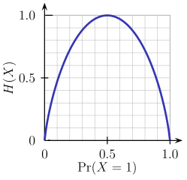
Entropy
Entropy is a measure of the randomness in the information being processed.
It measures impurity or uncertainty in group of observations.
The higher the entropy, the harder it is to draw any conclusions from that information.
Flipping a coin is an example of an action that provides information that is random.

Slide 33

From the above graph, it is quite evident that the entropy H(X) is zero when the probability is either 0 or 1.
The Entropy is maximum when the probability is 0.5 because it projects perfect randomness in the data and there is no chance of perfectly determining the outcome.
ID3 follows the rule — A branch with an entropy of zero is a leaf node and A brach with entropy more than zero needs further splitting.
Mathematically Entropy for 1 attribute is represented as:

Slide 34
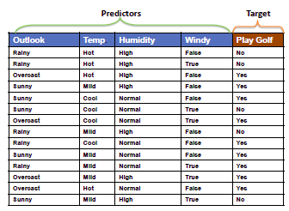

Slide 35
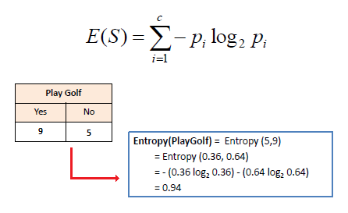
Where S → Current state, and Pi → Probability of an event i of state S or Percentage of class i in a node of state S.
Probability that the situation is play = 9 / 14
Probability that the situation not to play = 5 / 14
Calculating the Entropy for one attribute,
Entropy(Play Golf) = Entropy(5, 9)
= Entropy(5/14, 9/14) = Entropy(0.36, 0.64)
= -(0.36 log2 0.36) – (0.64 log2 0.64)
= 0.94

Slide 36
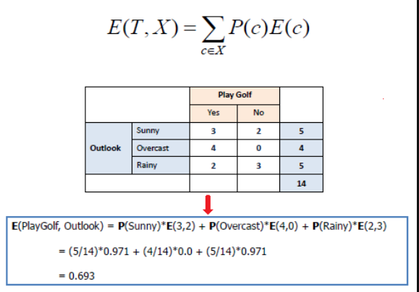
where T→ Current state and X → Selected attribute

Slide 37
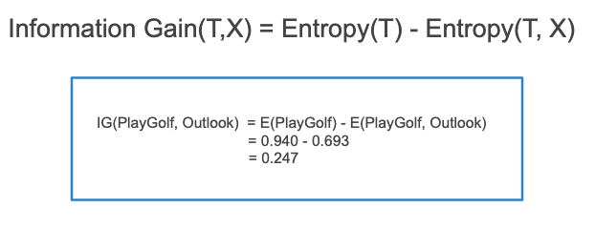
Calculating the Entropy for more than one attribute,
E(T, X) = ∑ P(c) E(c)
E(PlayGolf, Outlook) = P(Sunny)*E(3,2) + P(Overcast)*E(4,0) + P(Rainy)*E(2,3)
= (5/14) * 0.971 + (4/14) * 0 + (5/14) * 0.971 = 0.693
Information Gain
Information gain or IG measures how well a given attribute separates the training examples according to their target classification.
Constructing a decision tree is all about finding an attribute that returns the highest information gain and the smallest entropy.
Information gain computes the difference between entropy before split and average entropy after split of the dataset based on given attribute values.
ID3 (Iterative Dichotomiser) decision tree algorithm uses information gain.

Slide 38
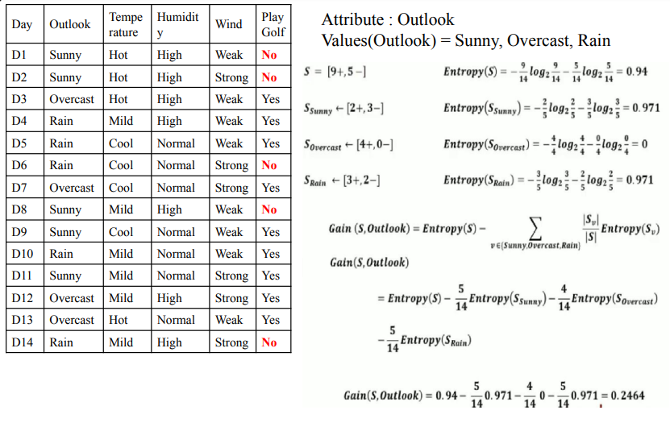

Slide 39
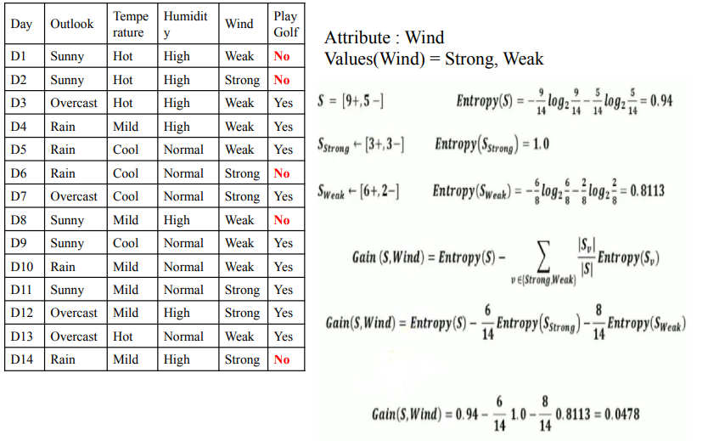

Slide 40
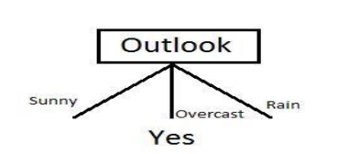
After calculating information gain for all attributes:
Gain(S,Outlook)= 0.2464, Gain(S,Temperature)= 0.0289 Gain(S,Humidity)=0.1516
Gain(S,Wind) =0.0478
We can clearly see that IG(S, Outlook) has the highest information gain of 0.246, hence we chose Outlook attribute as the root node. At this point, the decision tree looks like.

Slide 41
Here we observe that whenever the outlook is Overcast, Play Golf is always ‘Yes’
the simple tree resulted because of the highest information gain is given by the attribute Outlook.
 Now how do we proceed from this point? We can simply apply recursion.
 Now that we’ve used Outlook, we’ve got three of them remaining Humidity, Temperature, and Wind. And, we had three possible values of Outlook: Sunny, Overcast, Rain.
 Where the Overcast node already ended up having leaf node ‘Yes’, so we’re left with two subtrees to compute: Sunny and Rain.

Slide 42
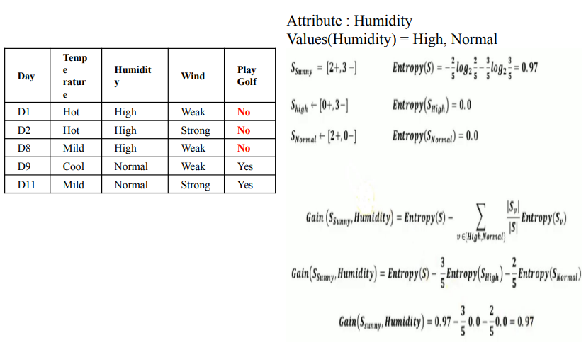

Slide 43
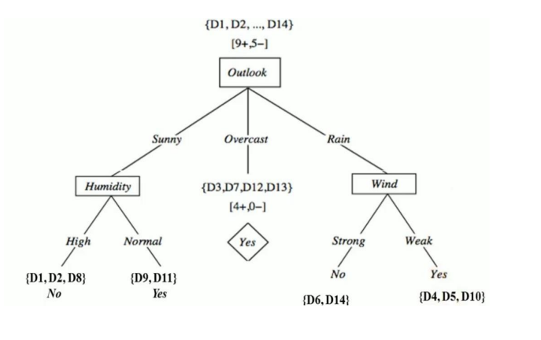

Slide 44
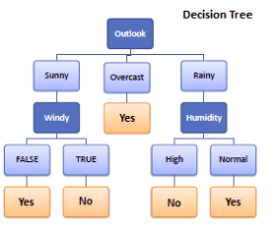

Slide 45
Inductive learning
 Inductive learning also known as discovery learning, is a process where the learner discovers rules by observing examples.
 We can often work out rules for ourselves by observing examples. If there is a pattern; then record it.
 We then apply the rule in different situations to see if it works.
 With inductive language learning, tasks are designed specifically to guide the learner and assist them in discovering a rule.

Slide 46
 Inductive learning: System tries to make a “general rule” from a set of observed instances.
 Example:
Mango → f(Mango) -> sweet (e1)
Banana → f(Banana) -> sweet (e2) …..
Fruits → f(Fruits) → sweet (general rule)

Slide 47
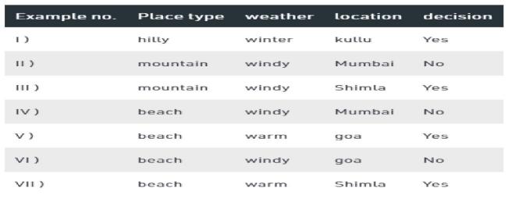
Example
Suppose an example set having attributes - Place type, weather, location, decision and seven examples.
 Our task is to generate a set of rules that under what condition what is the decision.

Slide 48
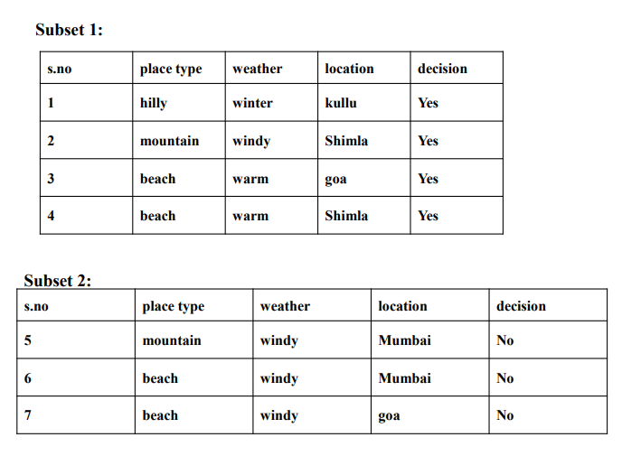

Slide 49
at iteration 1
row 3 & 4 column weather is selected and row 3 & 4 are marked.
the rule is added to R IF weather is warm then a decision is yes.
 at iteration 2
row 1 column place type is selected and row 1 is marked.
the rule is added to R IF place type is hilly then the decision is yes.
 at iteration 3
row 2 column location is selected and row 2 is marked.
the rule is added to R IF location is Shimla then the decision is yes.
 at iteration 4
row 5&6 column location is selected and row 5&6 are marked.
the rule is added to R IF location is Mumbai then a decision is no.
 at iteration 5
row 7 column place type & the weather is selected and row 7 is marked. rule is added to R IF place type is beach AND weather is windy then the decision is no.

Slide 50
